Slide 1
FLIGHT PRICE PREDICTION PROJECT
By –SHARUKH ANSARI

Slide 2
Problem Statement
In this project we need to extract data and build a model which can predict the price of ticket on a particular day or month
Anyone who has booked a flight ticket knows how unexpectedly the prices vary. The cheapest available ticket on a given flight gets more and less expensive over time. This usually happens as an attempt to maximize revenue based on -
1. Time of purchase patterns (making sure last-minute purchases are expensive)
2. Keeping the flight as full as they want it (raising prices on a flight which is filling up in order to reduce sales and hold back inventory for those expensive last-minute expensive purchases)
So, you have to work on a project where you collect data of flight fares with other features and work to make a model to predict fares of flights.

Slide 3
Data scrapping using selenium
Data collection:
We have to scrap the flights details such as name, date of journey, source, destination, route, departure time, arrival time, duration, total stops and the target variable price to make model and teach model how to predict the price of the ticket depend upon the various factor.
I have scrap the Paytm and extract the various features from that sites to make model

Slide 4
Analysis
Data Analysis:
After cleaning the data, you have to do some analysis on the data.
Do airfares change frequently? Do they move in small increments or in large jumps? Do they tend to go up or down over time?
What is the best time to buy so that the consumer can save the most by taking the least risk?
Does price increase as we get near to departure date? Is Indigo cheaper than Jet Airways? Are morning flights expensive?

Slide 5
Understanding
Optimal timing for airline ticket purchasing from the consumer’s perspective is challenging principally because buyers have insufficient information for reasoning about future price movements. In this project we majorly targeted to uncover underlying trends of flight prices in India using historical data and also to suggest the best time to buy a flight ticket.
Nowadays, airline ticket prices can vary dynamically and significantly for the same flight, even for nearby seats within the same cabin. Customers are seeking to get the lowest price while airlines are trying to keep their overall revenue as high as possible and maximize their profit.
Airlines use various kinds of computational techniques to increase their revenue such as demand prediction and price discrimination. From the customer side, two kinds of models are proposed by different researchers to save money for customers: models that predict the optimal time to buy a ticket and models that predict the minimum ticket price.
From the customer point of view, determining the minimum price or the best time to buy a ticket is the key issue. The concept of “tickets bought in advance are cheaper” is no longer working. It is possible that customers who bought a ticket earlier pay more than those who bought the same ticket later.

Slide 6
Understanding
Moreover, early purchasing implies a risk of commitment to a specific schedule that may need to be changed usually for a fee. The ticket price may be affected by several factors thus may change continuously.
To address this, various studies were conducted to support the customer in determining an optimal ticket purchase time and ticket price prediction.

Slide 7
Exploratory data analysis
Importing the dataset:
Importing the dataset using the “read_csv()” function of the Pandas library. This function can read a CSV file (either locally or through a URL) and also perform various operations on it.
df = pd.read_csv(“Final dataset(in csv).csv")
Extracting the independent variable.
To extract the independent variables, we used drop function of the Pandas library.
X = df.drop(“fare", axis = 1)
Here df is the data set which contains the independent and dependent variable after removing outliers and cleaning the data. Dropping the price variable from the dataset and storing it in other variable Y.

Slide 8
Exploratory data analysis
Extracting dependable variable.
To extract the dependent variables, we used following function.
Y = df[“fare”]
Removing outliers from the data using interquartile method.
Splitting the data and then removing skewness.
Removing skewness from the data.
Scaling the data using standard scaler so that there is no biasness during model learning.
Splitting the data:
x_train,x_test,y_train,y_test = train_test_split(X,Y,test_size = .30,random_state = 27)

Slide 9
Visualization

Slide 10
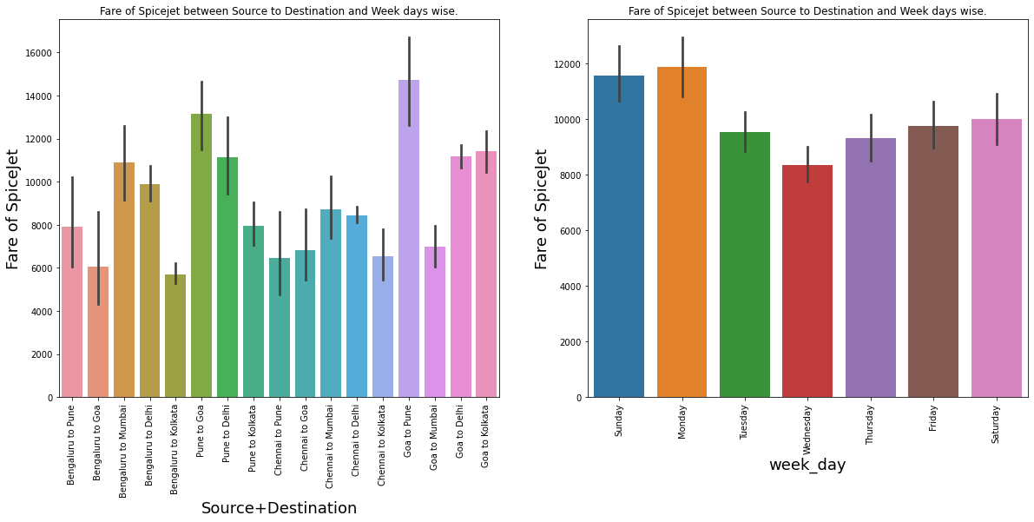

Slide 11
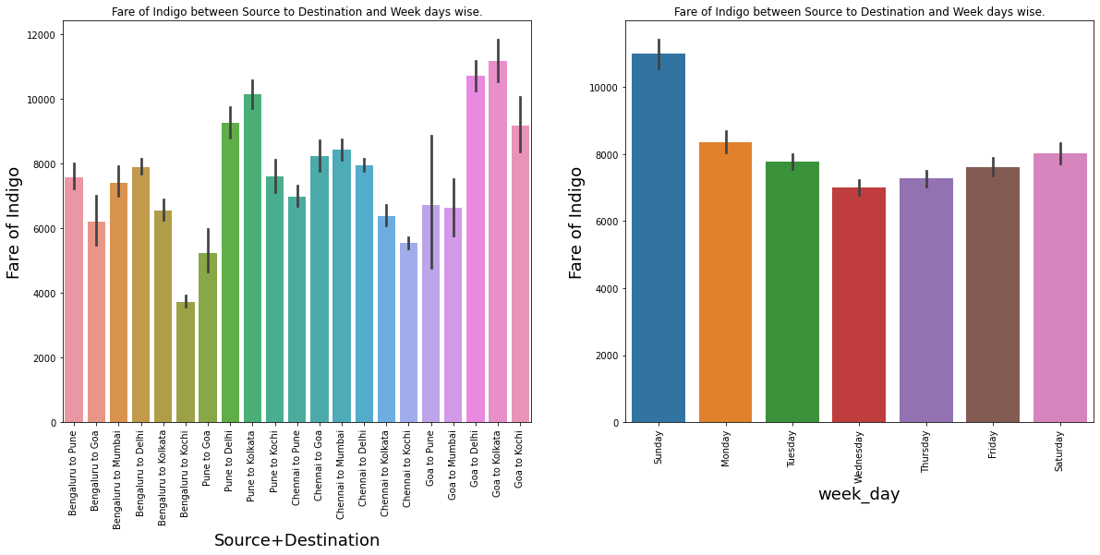

Slide 12
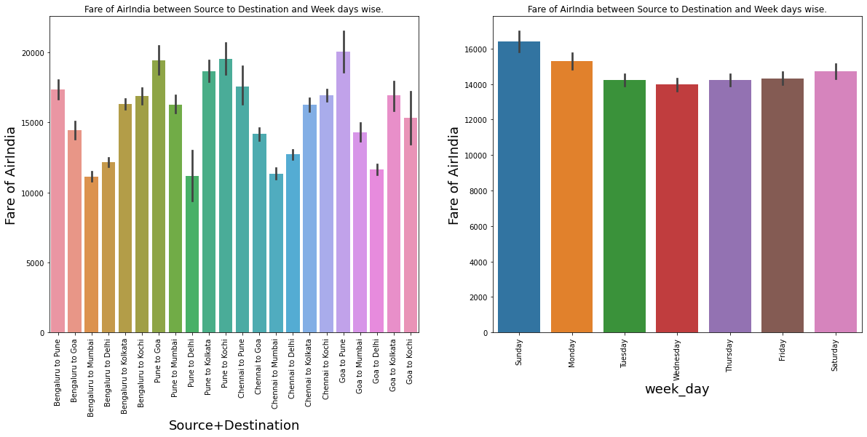

Slide 14
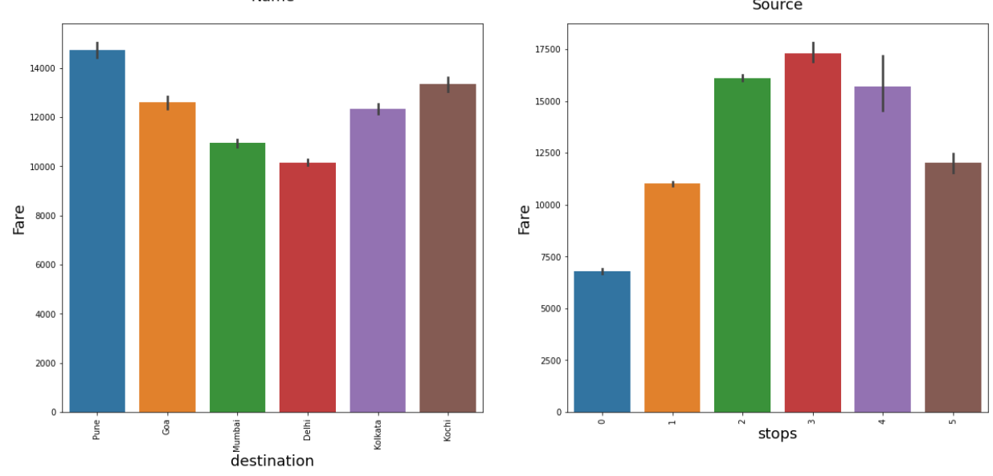
Destination and Total number of stops vs fare

Slide 15
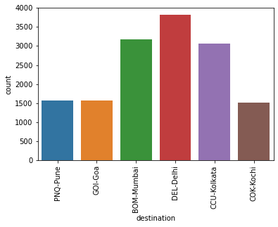
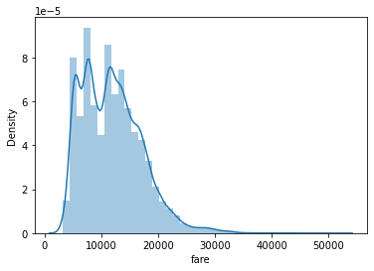
Airline Name
Price Distribution

Slide 16
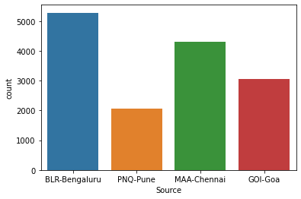
Source
Destination

Slide 17
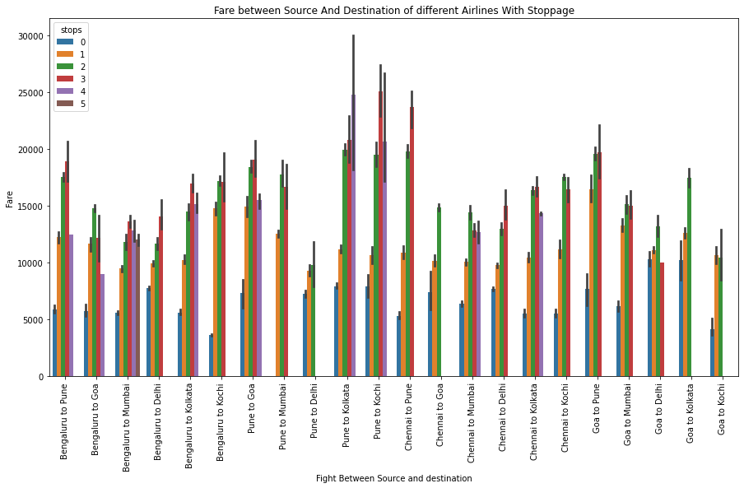

Slide 18
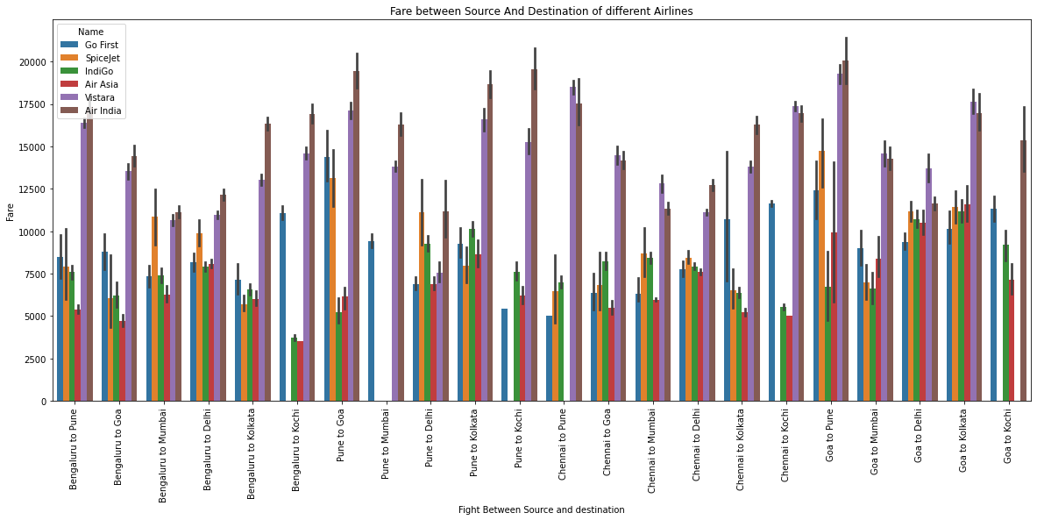

Slide 19
Heat Map(Correlation)

Slide 20
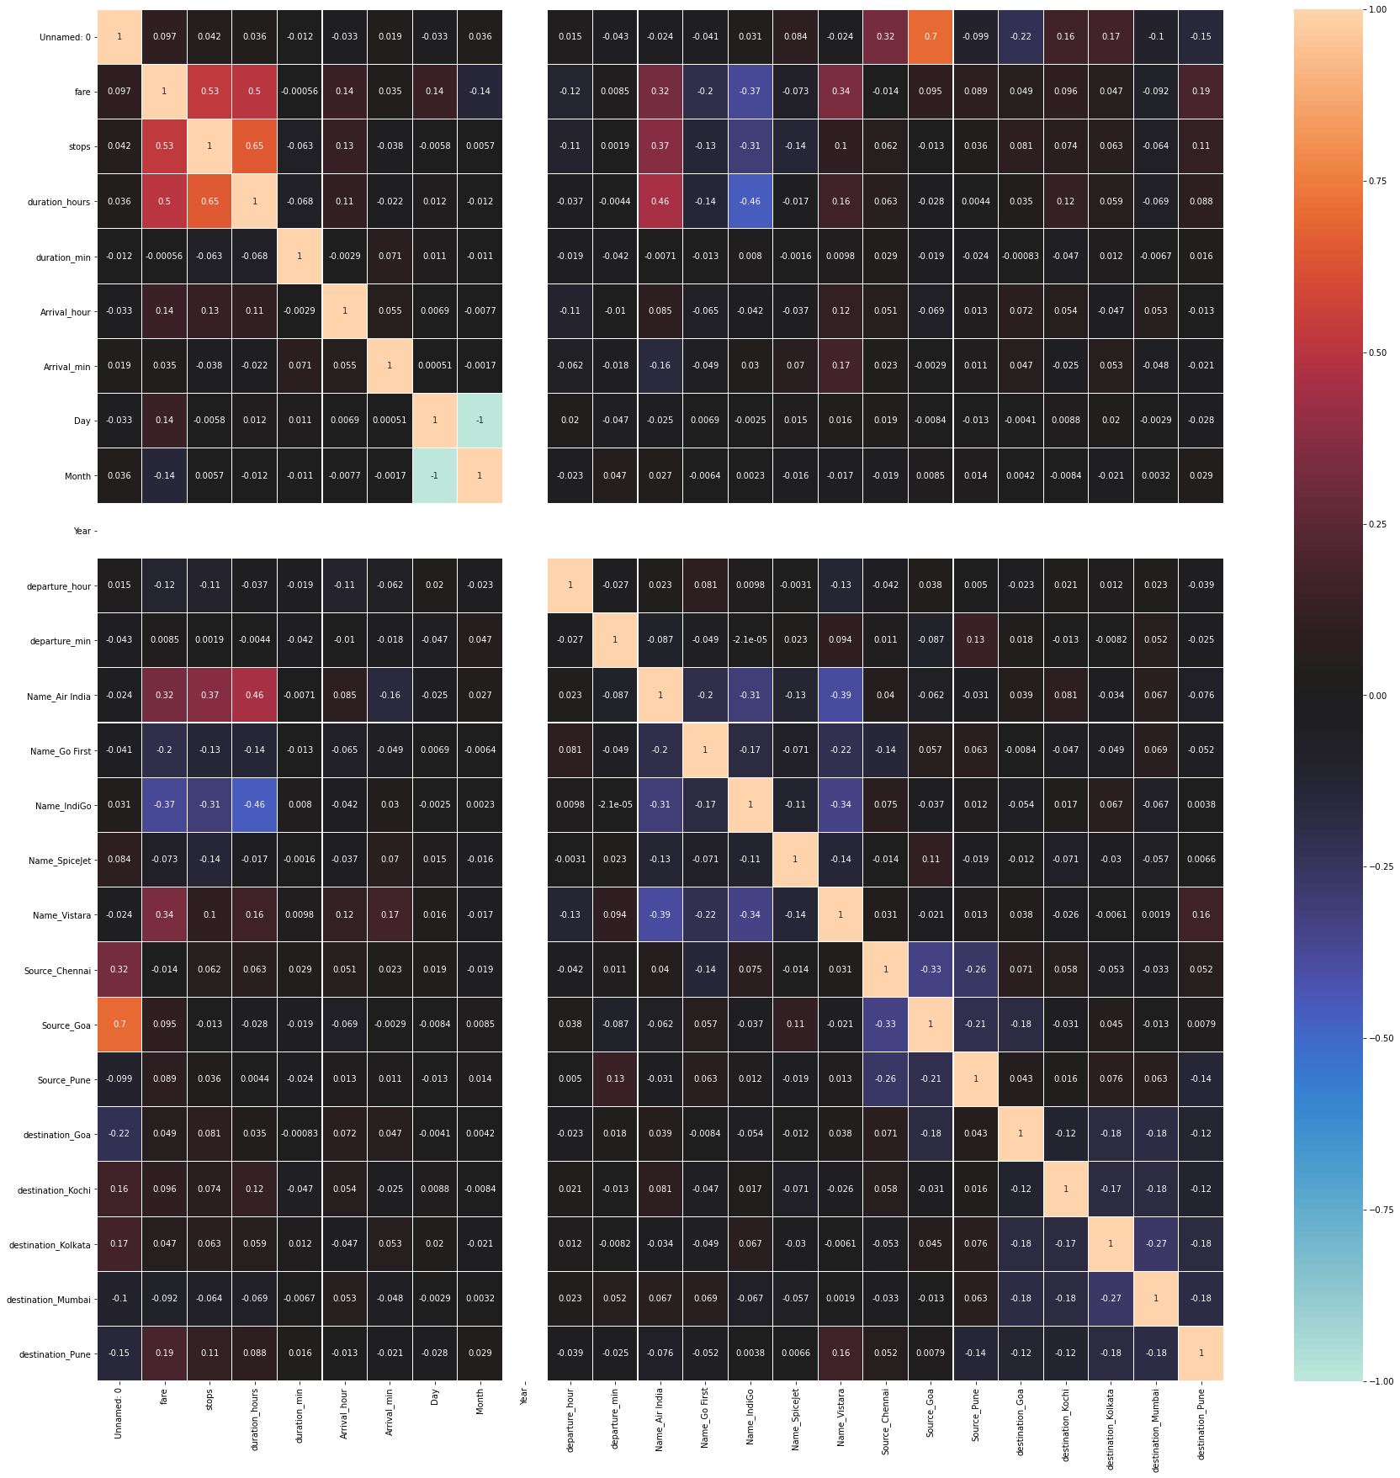

Slide 21
Relationship of the Flight price with other features.

Slide 22
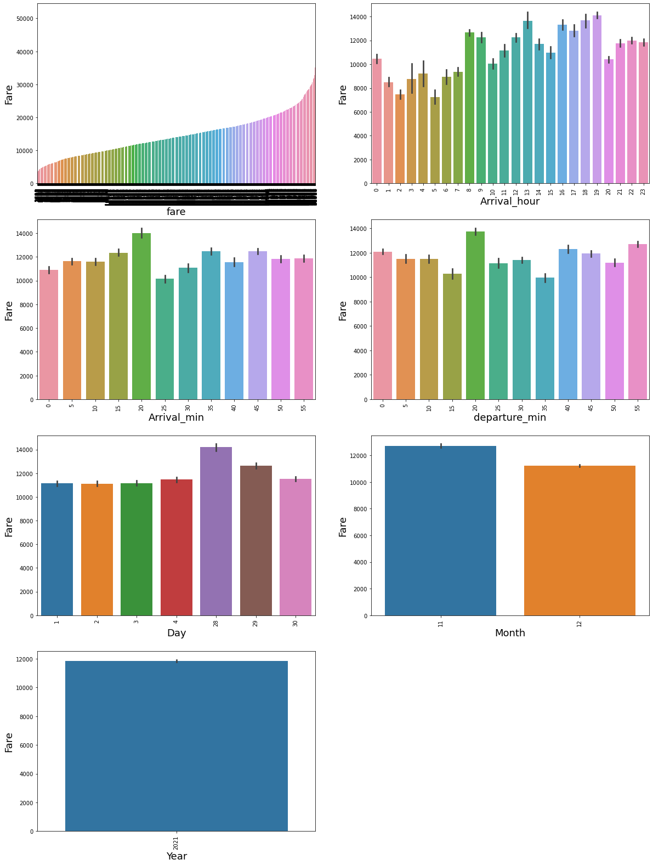

Slide 23
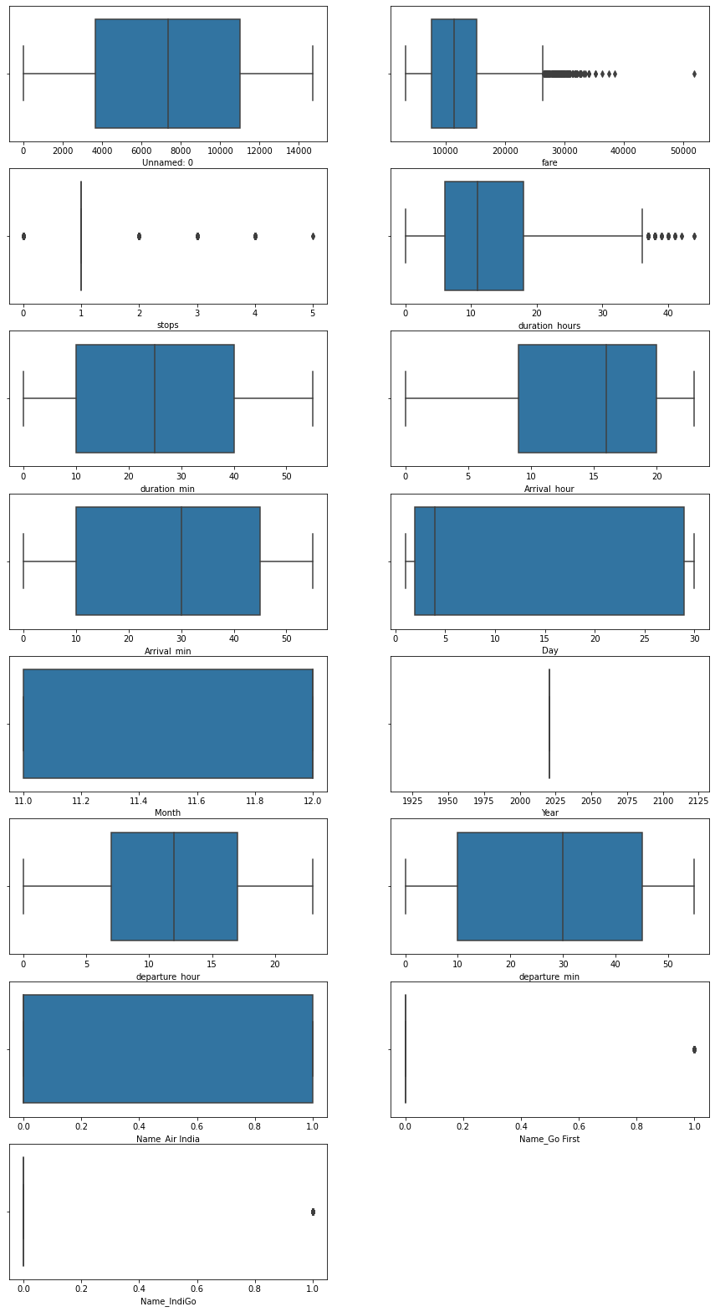
Box plots

Slide 24
Steps and assumption.
The non-stop in total number of stops is replaced by 0.
The name of the city Bengaluru and Bangalore are the same.
The date of scrapping the data from the web was 28th November 2021

Slide 25
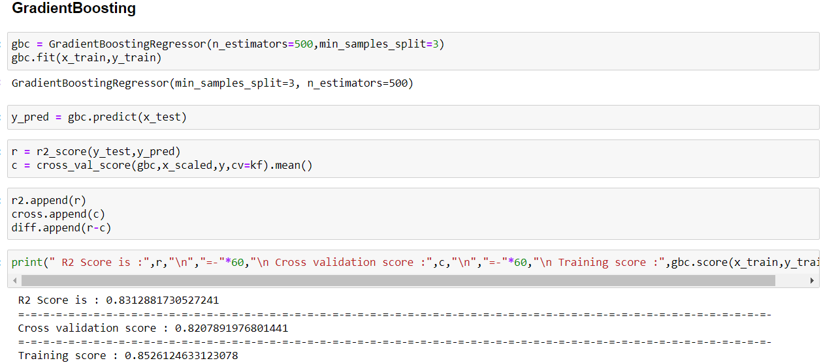
Model selection
Gradient Boosting

Slide 26
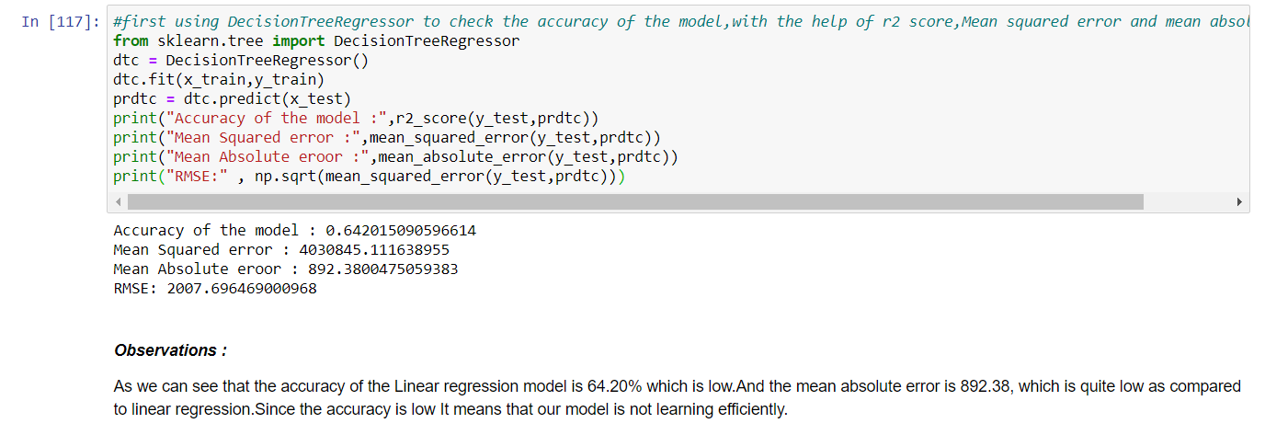
Model selection
Decision Tree Regressor

Slide 27
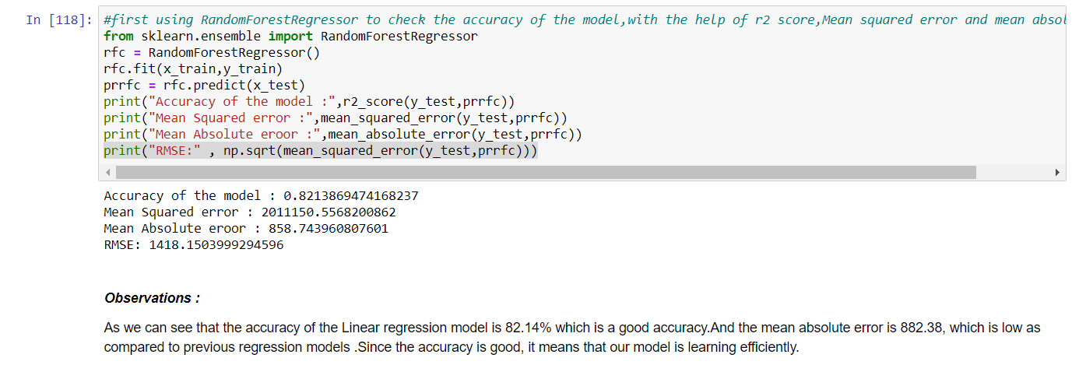
Model selection
Random Forest Regressor

Slide 28
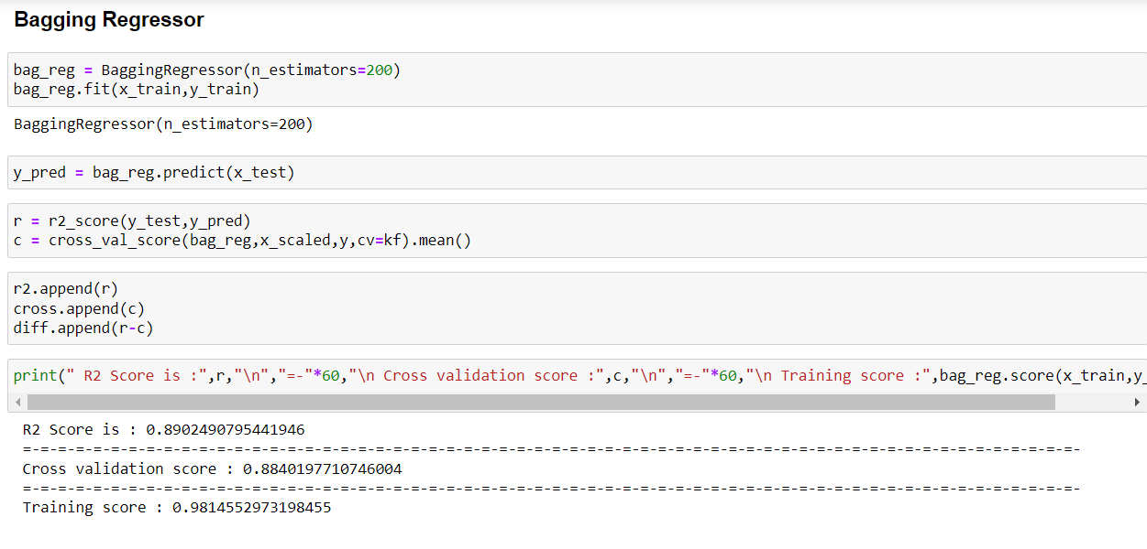
Model selection
Bagging Regressor

Slide 29
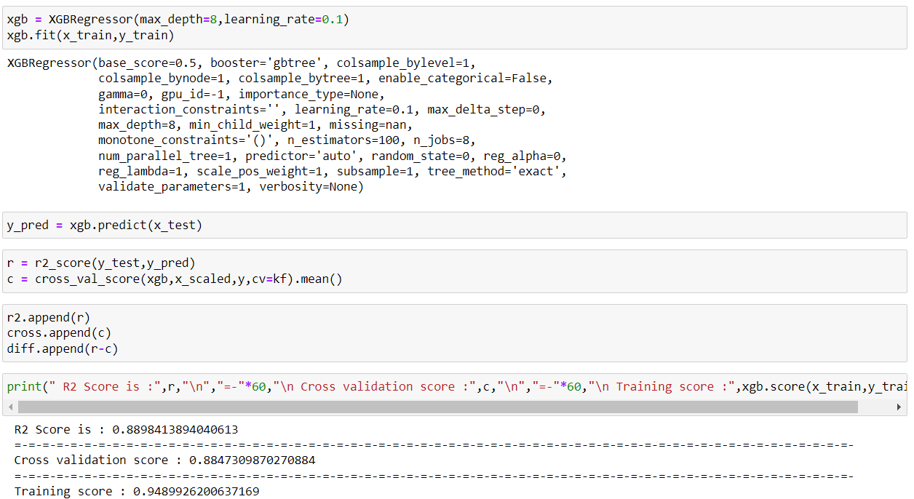
Model selection
XGB Regressor

Slide 30
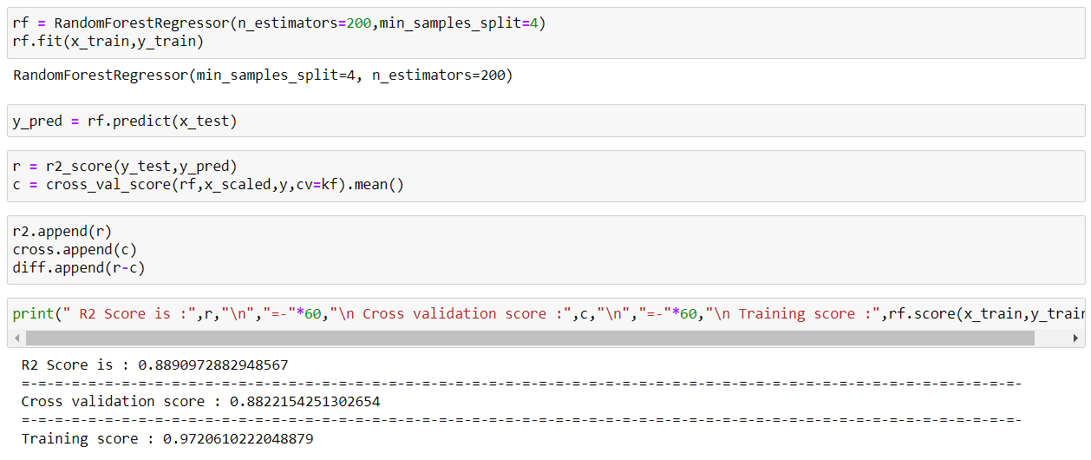
Model selection
RandomForest Regressor

Slide 31
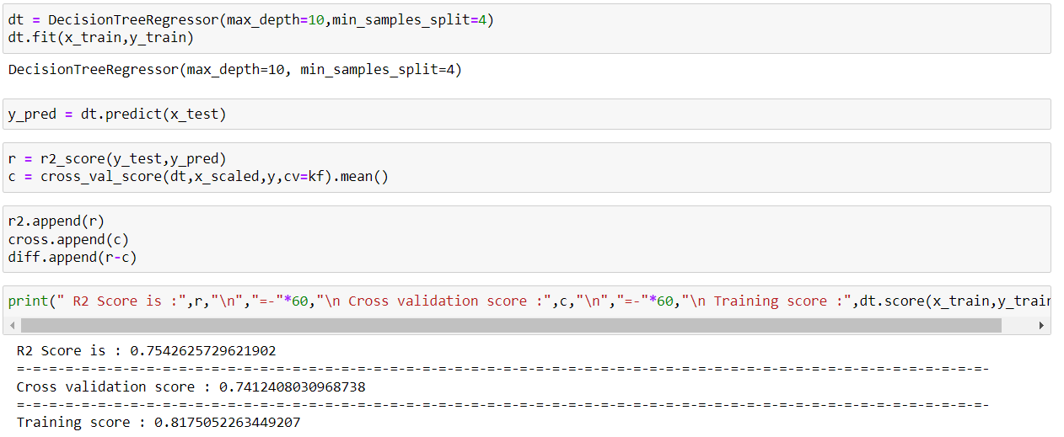
Model selection
DecisionTree Regressor

Slide 32
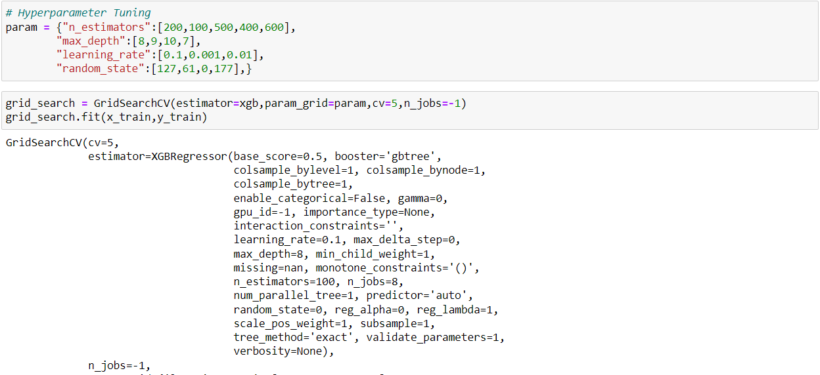
Final Model
XGB Regressor(after hyperparameter tuning)

Slide 33
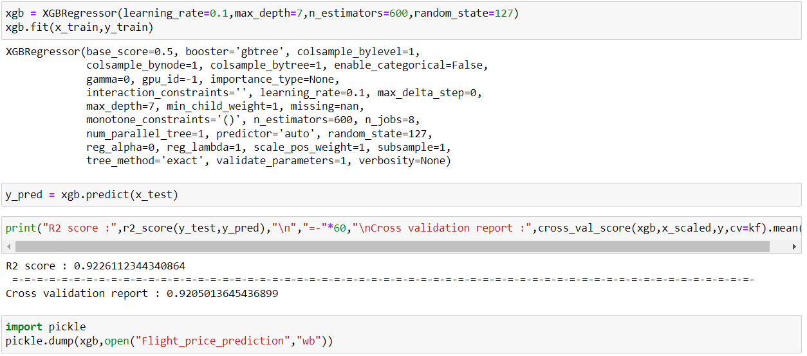
Final Model
XGBRegressor (after hyperparameter tuning)

Slide 34
Conclusion
Optimal timing for airline ticket purchasing from the consumer’s perspective is challenging principally because buyers have insufficient information for reasoning about future price movements. In this project we majorly targeted to uncover underlying trends of flight prices in India using historical data and also to suggest the best time to buy a flight ticket.
Nowadays, airline ticket prices can vary dynamically and significantly for the same flight, even for nearby seats within the same cabin. Customers are seeking to get the lowest price while airlines are trying to keep their overall revenue as high as possible and maximize their profit. Therefore various models are proposed to save money for customers: models that predict the optimal time to buy a ticket and models that predict the minimum ticket price.
By performing different models, it was aimed to get different perspectives and eventually compared their performance. With this study, it purpose was to predict prices of flights. For this project, we have collected data from 8 routes across India. The dataset contains 9 columns and 14647 rows after cleaning. With the help of the data visualizations and exploratory data analysis, the dataset was uncovered and features were explored deeply.

